Slide 1
LIBRARY MANAGEMENT SYSTEM Carried out by student of MCA Mr. Tanmay Shrikant Jogalekar Ms. Sanika Chandrashekhar Joshi Ms. Neha Prakash Jog
Hope Foundation’s Finolex Acadamy of Management & Technology
Ratnagiri
A Project Report on
Project Guide : Prof. Supriya S. Surve

Slide 2
INTRODUCTION
Library management system is a project which aims in developing a computerized system to maintain all the daily work of library .
It has a facility of admin login through which the admin can monitor the whole system.
Admin modules are add new book, view books issue book and return book.
Overall this project of ours is begin developed to help the library administration, maintain the library in the best way possible and also reduce the human efforts.

Slide 3
OBJECTIVE
The main objective of the Library Management System is to manage the details of books, members, book issue and book return. It manages all the information about book return. The project is totally built at administrative end and thus only the administrator is guaranteed the access. The Purpose of the project is to build an application program to reduce the manual work for managing the books, Members, book issue and return. It tracks all the details about the book issue and return, books, members.

Slide 4
GOALS OF PROJECT
Provides the searching facilities based on various factors. Such as book issue and return date, Books, Add Books.
It tracks all the information of Member, Books.
Manage the information of members.
All the fields are validated and does not take invalid values.
It deals with monitoring the information and transactions of Books.
Editing, adding the updating of Records is improved which results in proper resource management of data.
Manage the information of Books.

Slide 5
NEED OF SYSTEM
There is always a need of system that will perform management of books, members, books issue and return records.
This system will reduce the manual operation required to maintain all the records.

Slide 6
PROJECT SCOPE
The project has a wide scope, as it is not intended to a particular organization. This project is going to develop generic software, which can be applied by any businesses organization. More over it provides facility to users. Also the software is going to provide a huge amount of summary data.

Slide 7
PROPOSED SYSTEM
The library Management system is available in the market that can serve librarian in all libraries to manage book issue and book return

Slide 8
MODULES
Librarian
Members

Slide 9
FRONTEND (LANGUAGE USED)
JAVA
BACKEND
MYSQL (DATABASE)

Slide 10
SOFTWARE USED
Netbeansn IDE (Integrated Development Environment)
MYSQL Workbench / XAMPP (for Mysql)

Slide 11
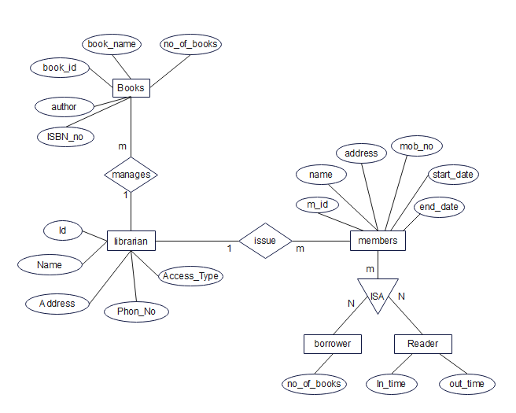
ER DIAGRAM

Slide 12
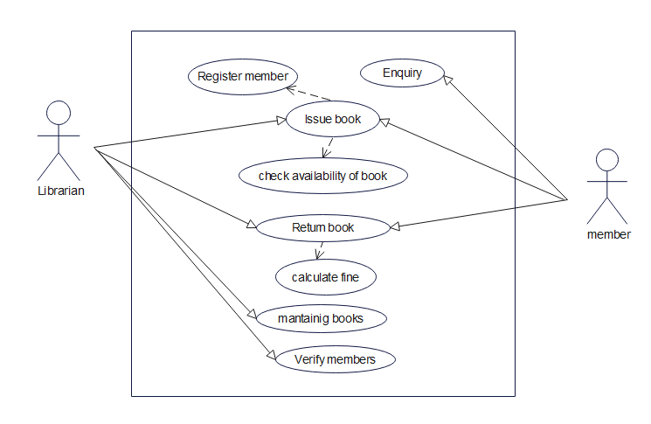
USECASE DIAGRAM

Slide 13
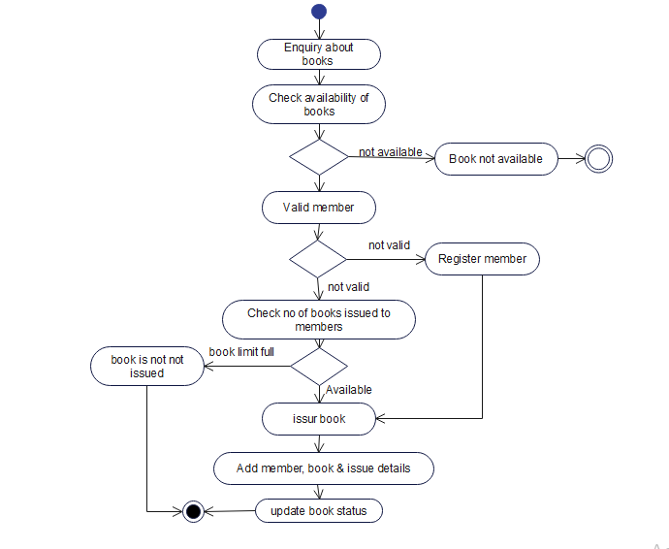
ACTIVITY DIAGRAM

Slide 14
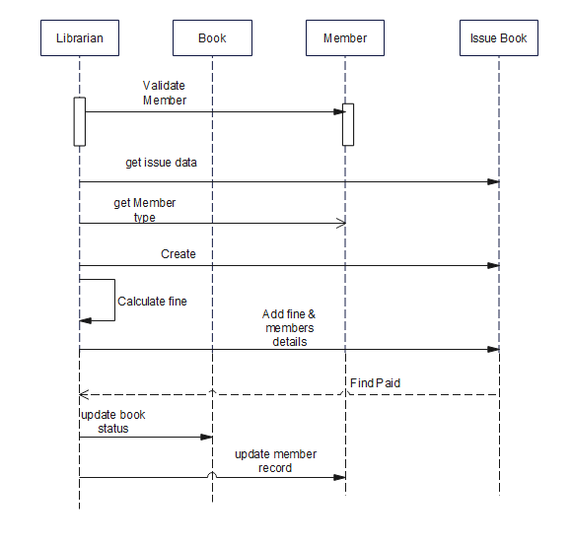
SEQUENCE DIAGRAM

Slide 15
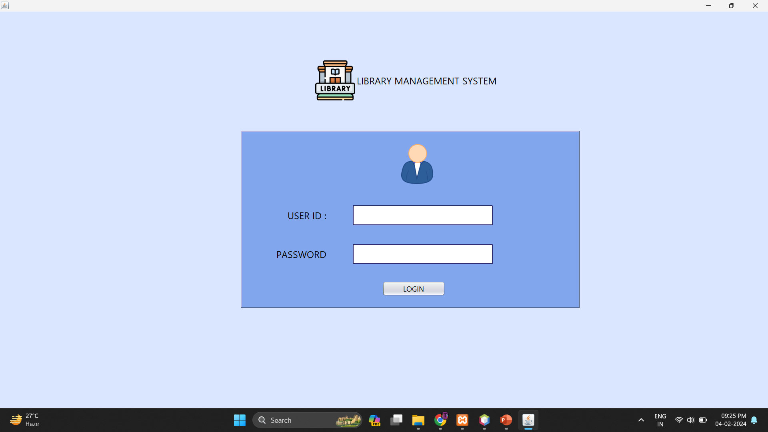
DESIGN OF PROJECT
Login page :-

Slide 16
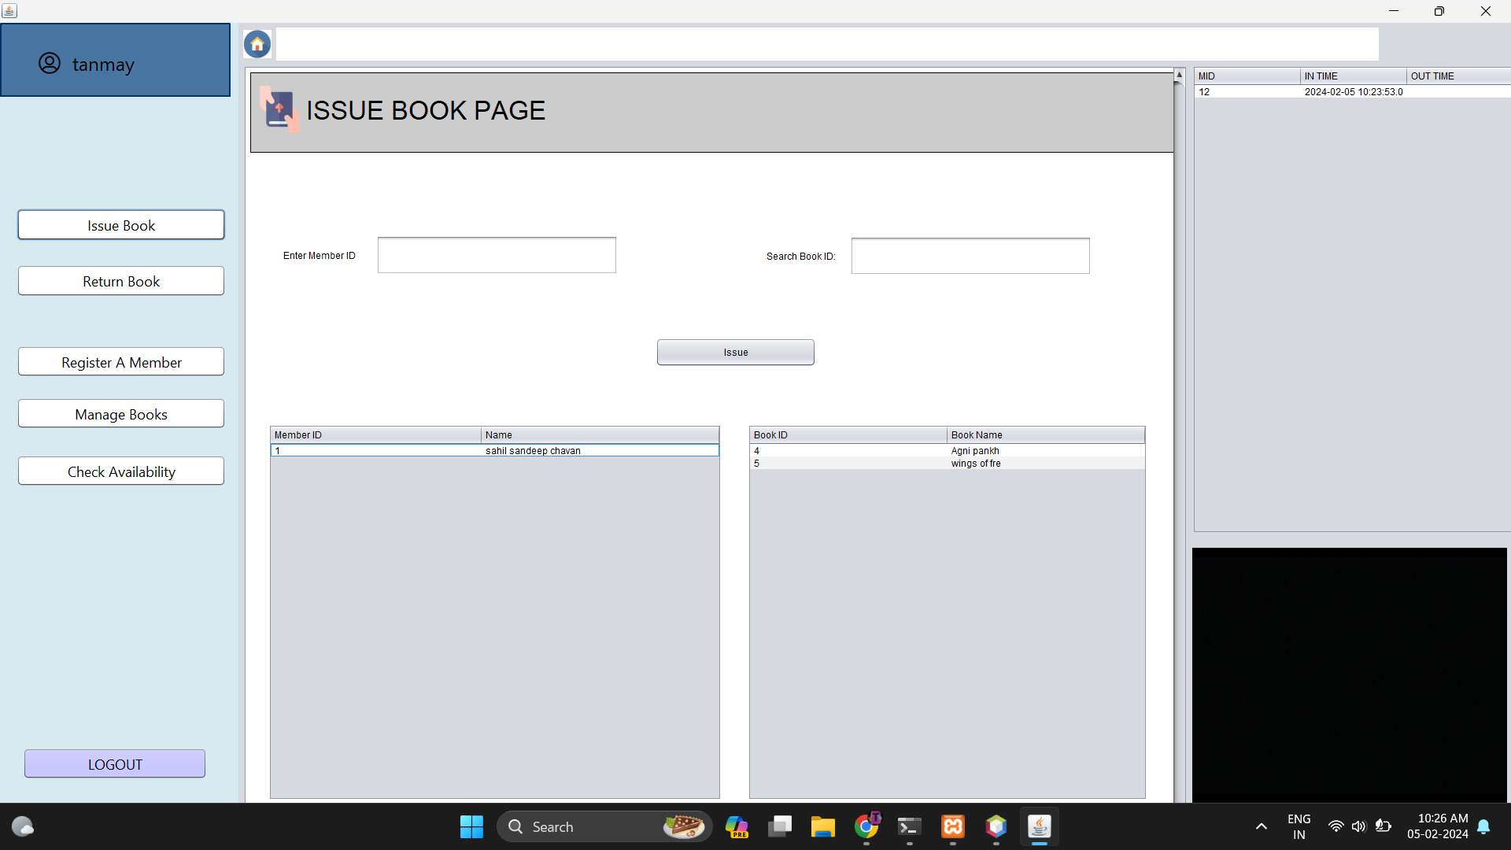
DESIGN OF PROJECT
Home page :-

Slide 17
CONCLUSION & FUTURE SCOPE
FUTURE SCOPE :
This desktop application involves almost all the basic features of the library management. The future implementation will be help for the members with website administrator.
CONCLUSION :
The project entitled “Library Management System” is developed using Java as a frontend and MYSQL database in backend to computerize the process of online management of books, issued and returned books. This project covers only the basic features required.

Slide 18
BIBLIOGRAPHY
www.java.sun.com/docs/books/tutorial
Kathy Sierra book
Wrox professional Java
www.javapoint.com

Slide 19
THANK YOU

